Slide 1

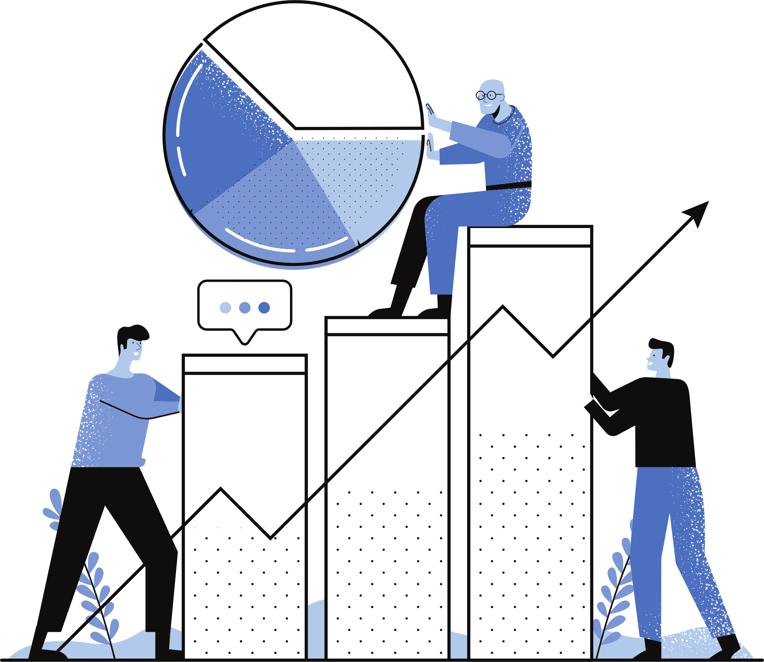
Group 5:
__init__()
aka: the first pecha kucha.

Slide 2


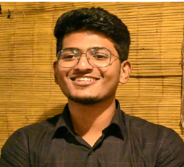
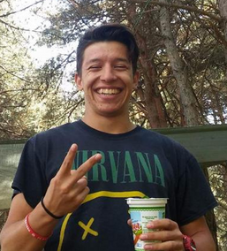
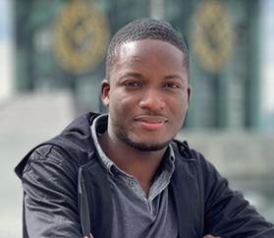
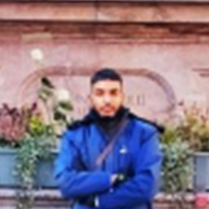
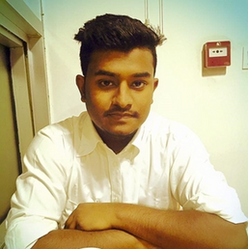

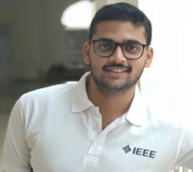
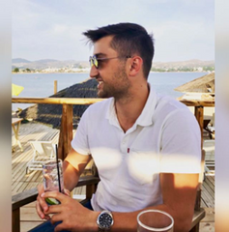
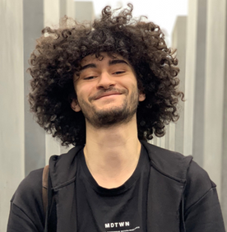
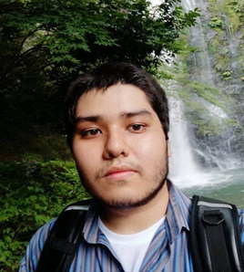
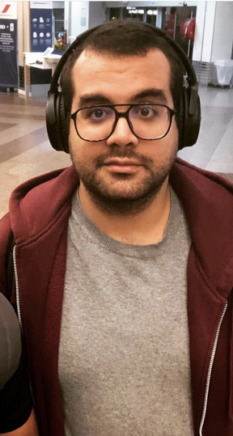


Melvin
Mathew
Hristo
Hriskov
Christian A. Gyampomah
Mohammad Mustafa
Sagor
Saha
Jack Of All Trades
Pseudo Engineer
Moncef's Boss
Web Artist
Deep Learning Practitioner
@Ml
@Web@Dep@Med
@ML
@Web Developer
Sai Thejeshwar Sharma
Adrian
Bali
Malek Ben
Alaya
Tayyab
Rehman
Moncef Ben Hadj Salem
ML Guru
Figuring Life Out
EI Student
Real Engineer
Assistant Reg Manager
@ML
@ML
@ML
@Web Developer
@Deployment@ml

Slide 3
Melvin
Mathew
Hristo
Hriskov
Christian A. Gyampomah
Mohammad Mustafa
Sagor
Saha
Jack Of All Trades
Pseudo Engineer
Moncef's Boss
Web Artist
Deep Learning Practitioner
@Ml
@Web@Dep@Med
@ML
@Web Developer
Sai Thejeshwar Sharma
Adrian
Bali
Malek Ben
Alaya
Tayyab
Rehman
Moncef Ben Hadj Salem
ML Guru
Figuring Life Out
EI Student
Real Engineer
Assistant Reg Manager
@ML
@ML
@ML
@Web Developer
@Deployment@ml

Slide 4










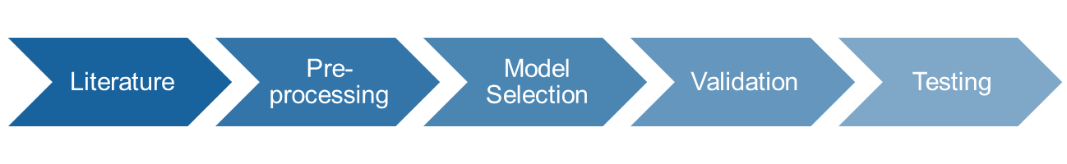
Team Organization
Machine Learning
Moncef
Christian
Sagor
Theja
Malek
Melvin

Slide 5





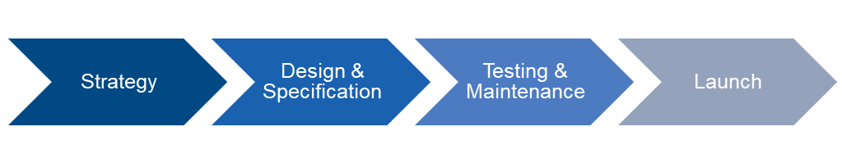
Team Organization
User Interface
Mustafa
Tayyab
Hristo

Slide 6


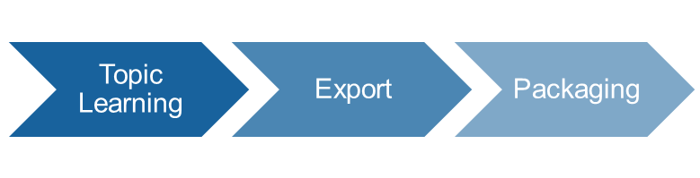
Team Organization
Deployment
Theja
Moncef
Hristo

Slide 7



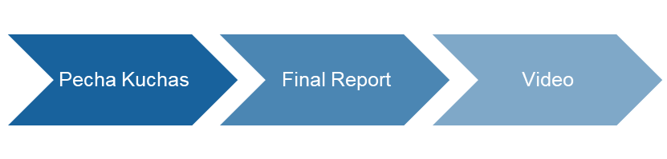
Team Organization
Media and Reports
Christian
Adrian
Hristo

Slide 8

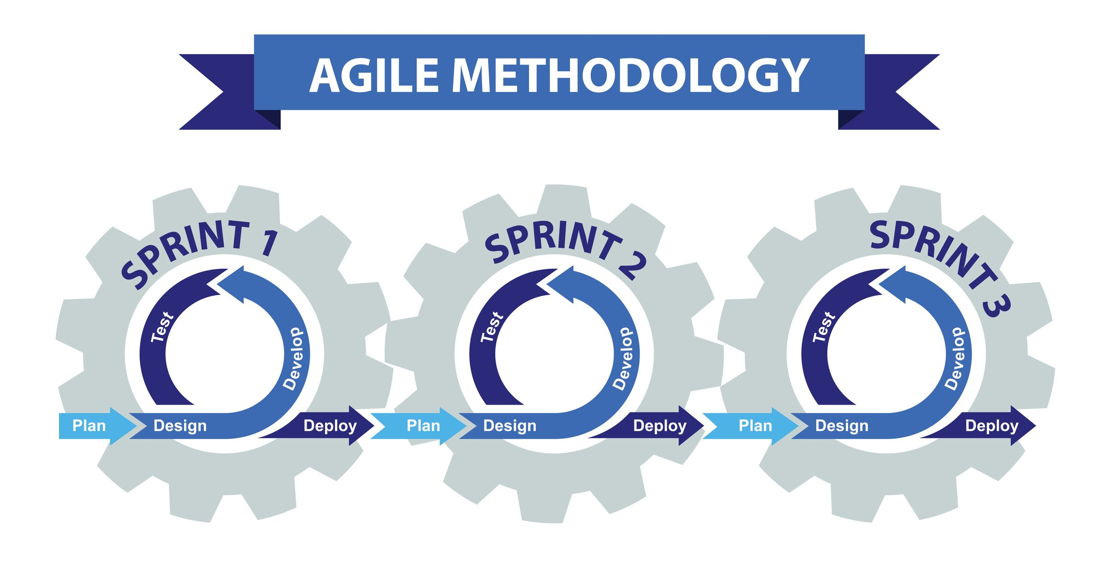
Methodology

Slide 9
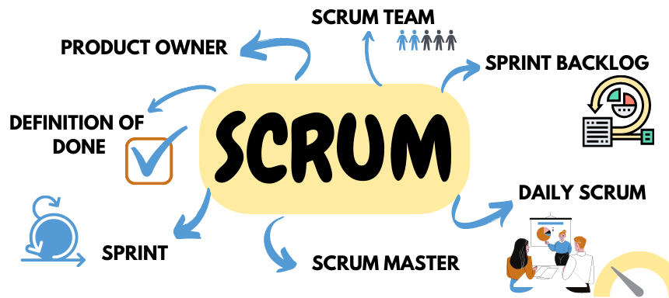
Methodology

Slide 10


Sprint 1
Week 1 - 3​
.
ML Team: Model development​.
Deployment Team: Learning Docker​.
Web team: Barebones web framework​.
Media Team: Pecha Kucha 2

Slide 11
Sprint 2
Week 4 - 6​
.
ML Team: Hyperparameter tuning.​
Deployment team: Assist ML team.​
Web team: Developing UI and API.​
Media team: Pecha Kucha 3

Slide 12
Sprint 3
Week 7 - 9​
.
ML team: Finalizing ML model
Deployment team: Deployment of containers.​
Web team: Integrating web with ML.
Media team: Assist ML team

Slide 13
After Sprint 3
Week 10 - 12
.
Video Editing​
Report​ compilation
Tying up loose ends.

Slide 14

Sprint meetings
Bi-weekly meeting
Small meetings.
Feedback and discussion.
Sprint Planning
Next sprint discussion.
Sprint Review

Slide 15










Our Style
Agreed cross-group
interfaces
Testing-oriented CI/CD
Dockerize program
Comment Code!

Slide 16
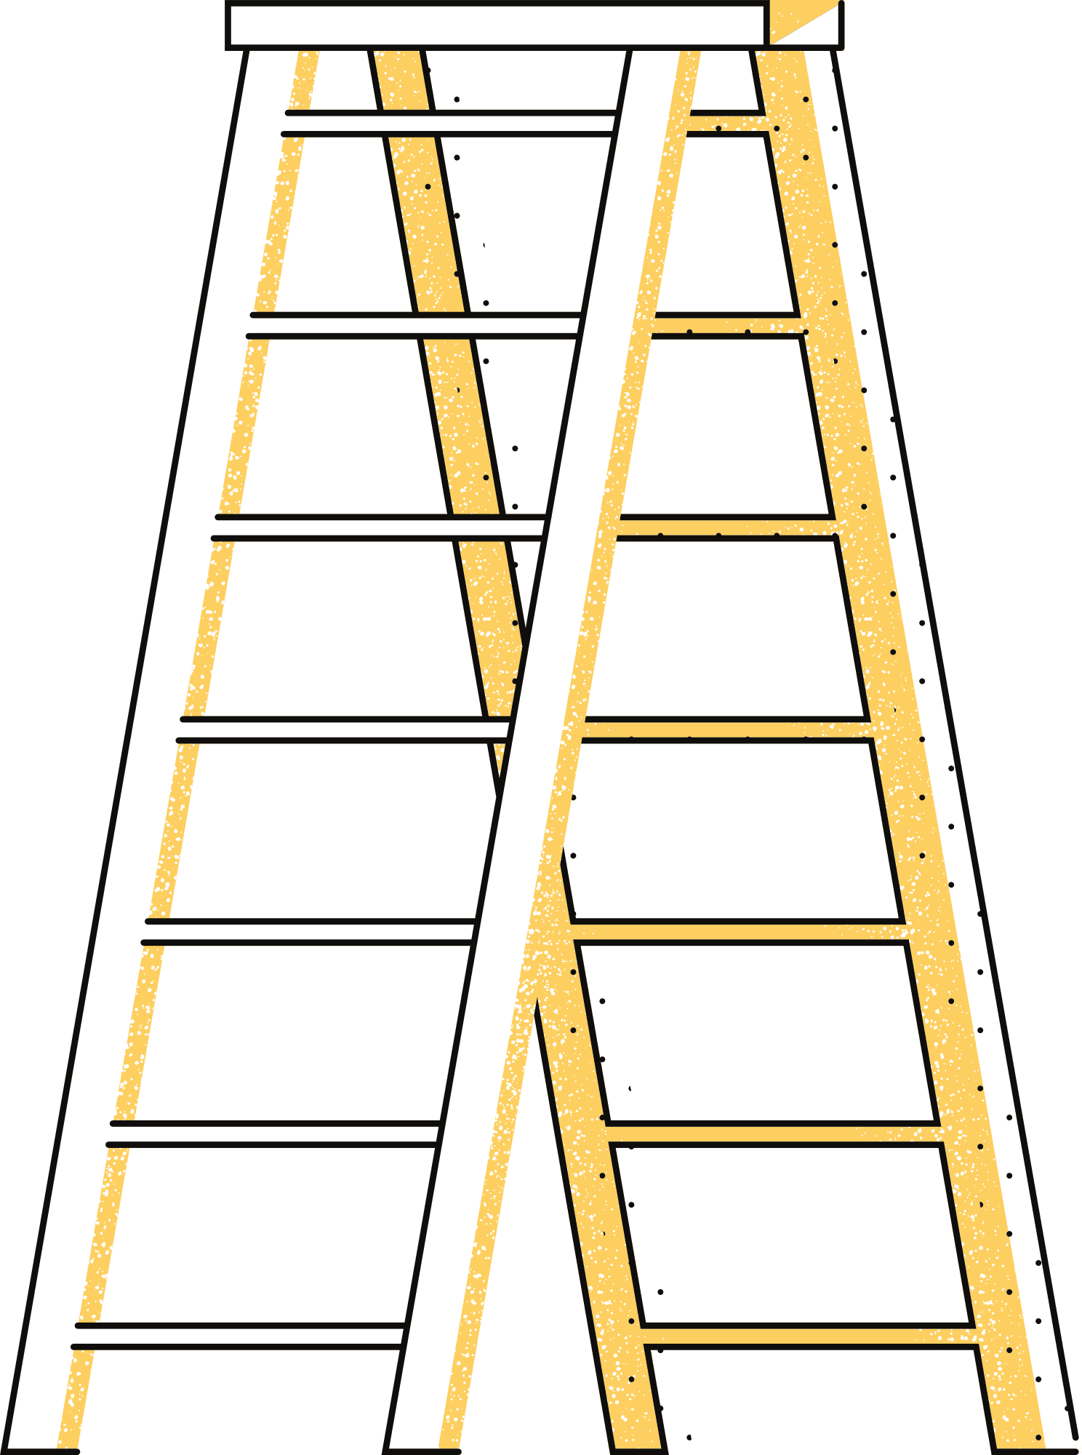
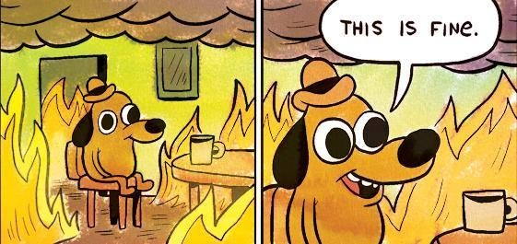
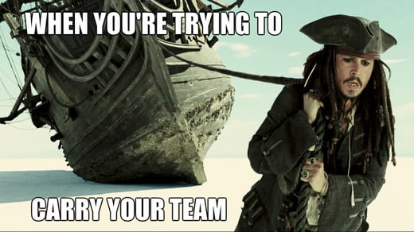
Anticipated Challenges

Slide 17


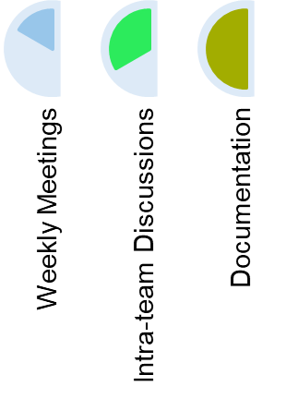
Anticipated Challenges:
Communication

Slide 18


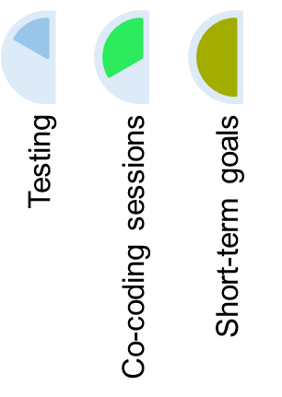
Anticipated Challenges:
Accountability

Slide 19


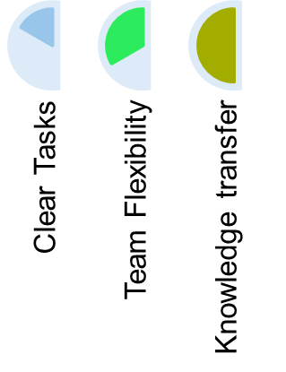
Anticipated Challenges:
Skill Imbalance

Slide 20

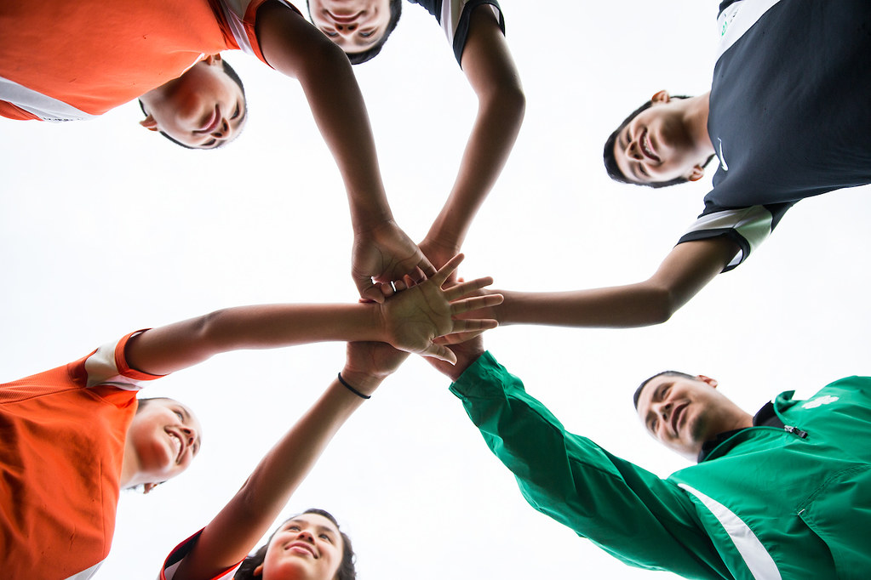
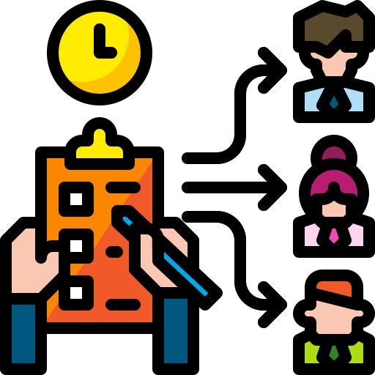


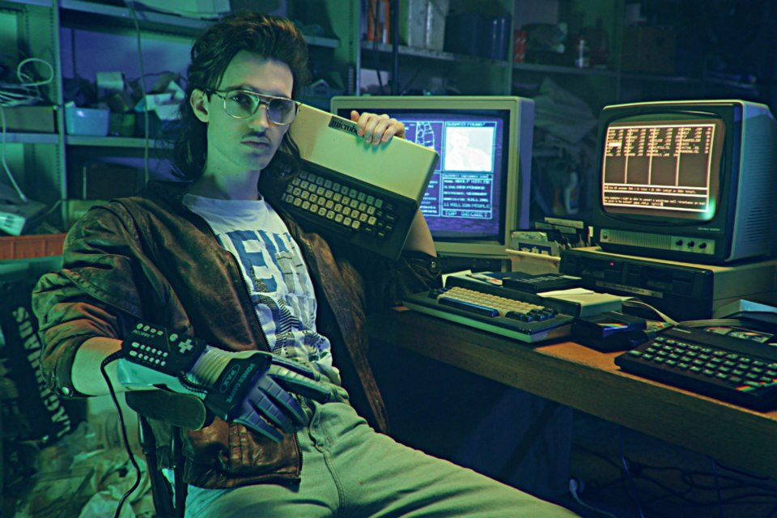
Learning goals
Project management
Collaboration
ML Gurus

Slide 21
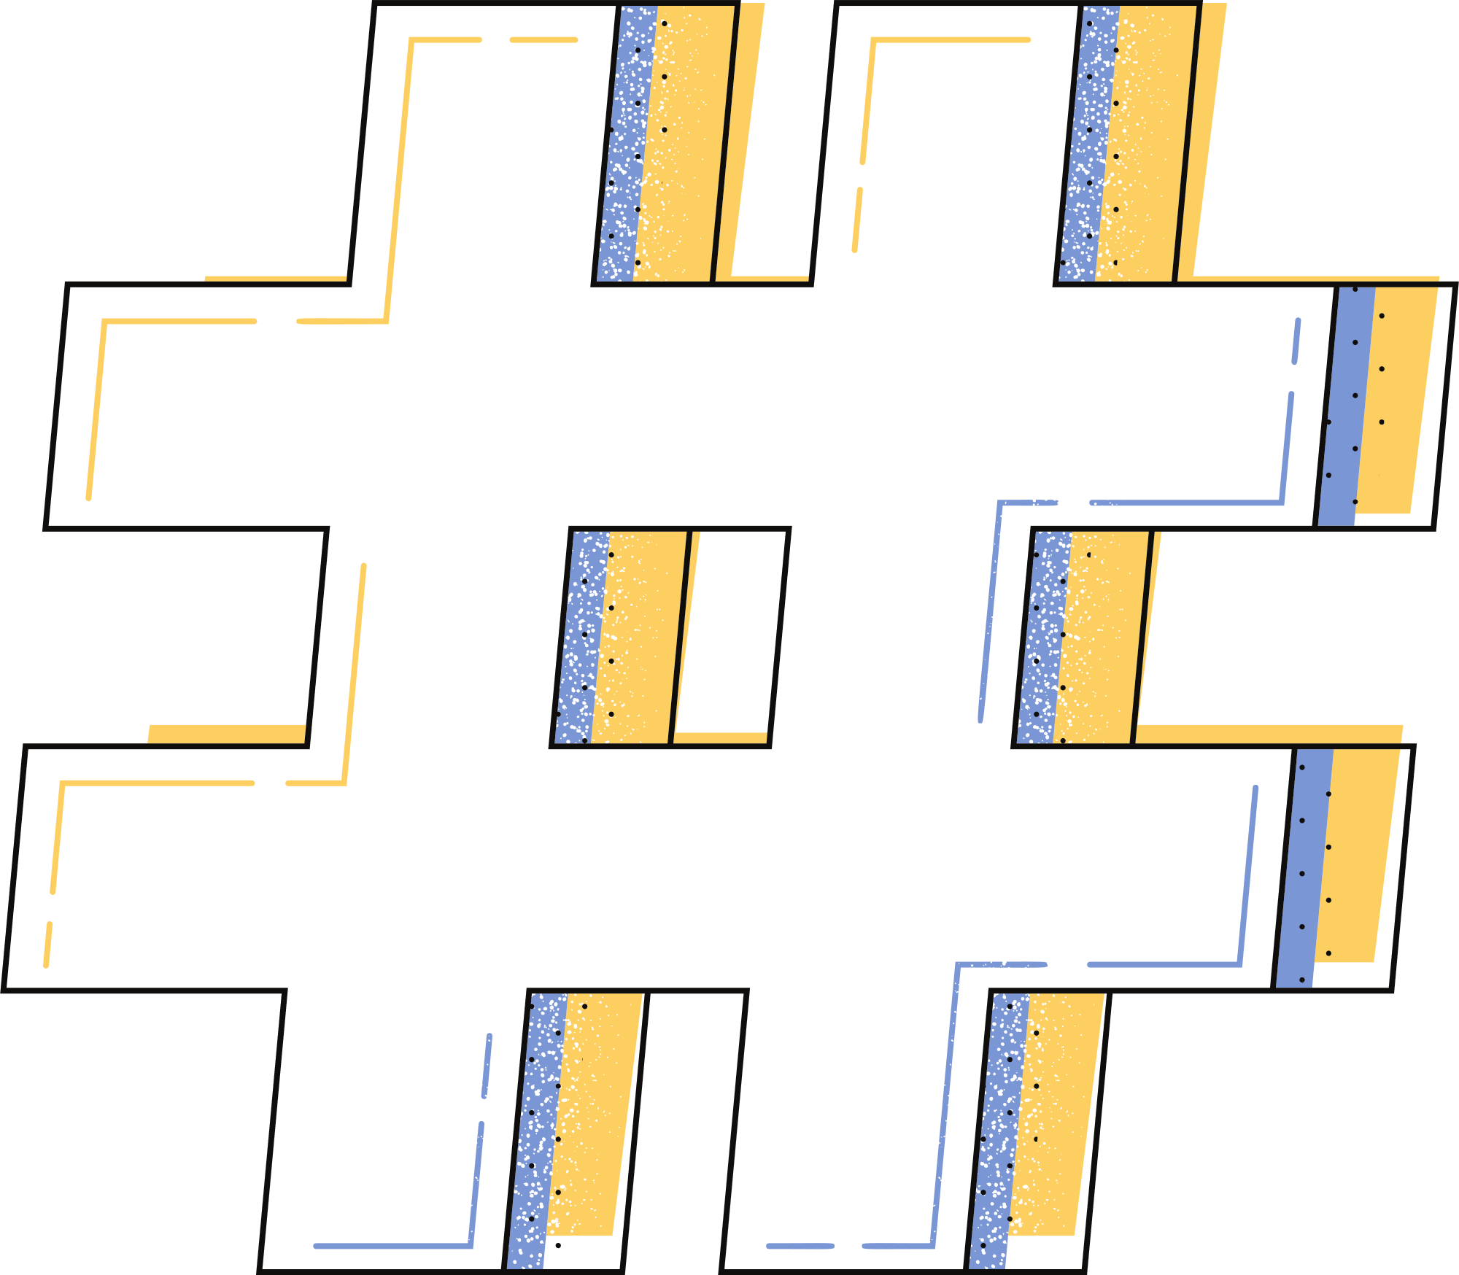
Summary
Conclusion
Teams
Tasks
Methodology
Execute
Timeline
>> group_5.execute()

